Slide 1
Applied Data Science Logistic Regression
Dr. Omri Allouche
2017

Slide 2
Refresher
Watch Week 3 of Andrew Ng’s https://www.coursera.org/learn/machine-learning

Slide 3
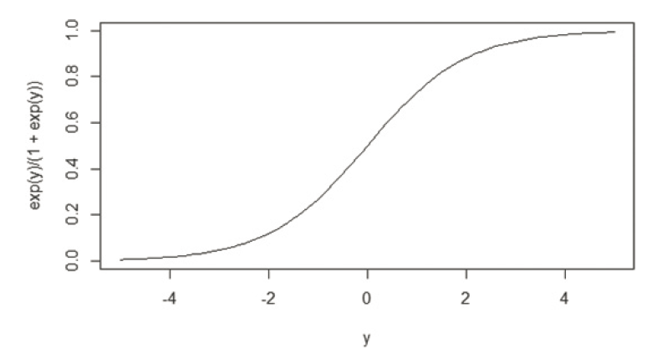



Logistic regression
Despite the name, is used for Classification, not Regression.
Can be extended to multiclass classification.
Based on the Logistic Function (Sigmoid), which is the inverse of the Logit function (odds ratio)

Slide 4
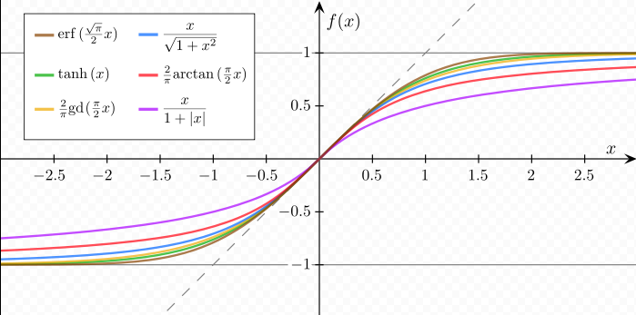
Sigmoid Functions
Notes:
all functions are normalized in such a way that their slope at the origin is 1.

Slide 5

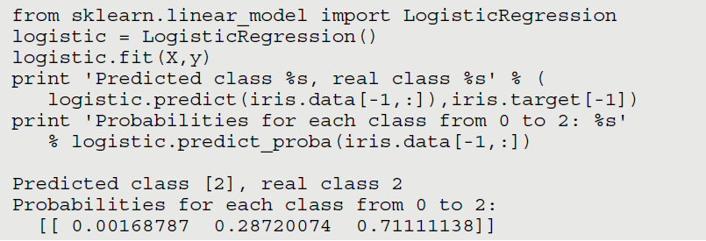
SCIKIT LEarn

Slide 6
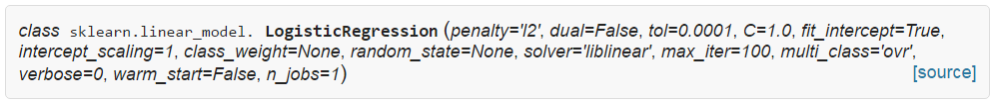
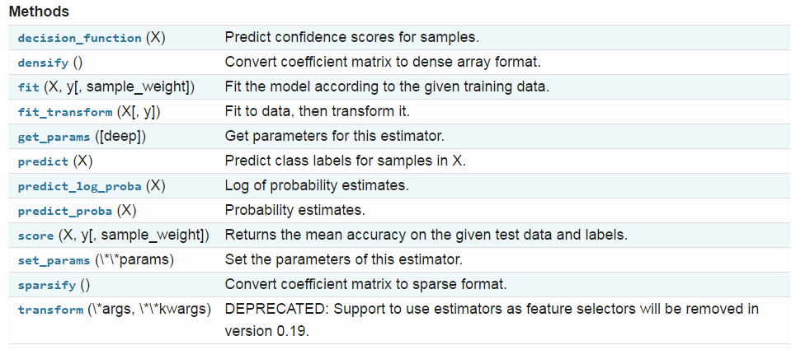
Methods

Slide 7
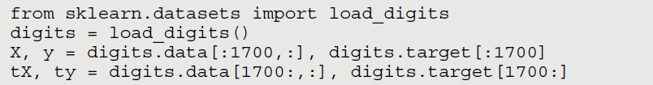
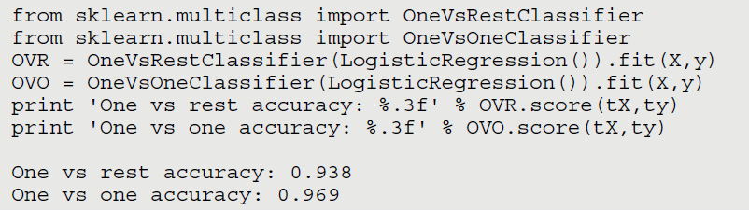
Handling Multiple Classes
One vs. Rest (SciKit Learn’s OneVsRestClassifier)
One vs. One (SciKit Learn’s OneVsOneClassifier)

Slide 8
Limitations
Can model categorical data
Gives probability (but usually used with a hard threshold)
Doesn’t handle missing values well
Sensitive to outliers
Assumes linear relationships
Doesn’t handle collinearity well

